Slide 1


International TOP ups Business presentation
February 2015

Slide 2

UK Telecom Distribution:
Key Numbers
United Kingdom’s no.1 in International Mobile Top-ups
Largest provider of Mobile Top-up – recharging in almost 130 Countries
United Kingdom’s no.1 in the prepaid Calling Cards Market
Over 15,000 outlets in global retail distribution network

Slide 3
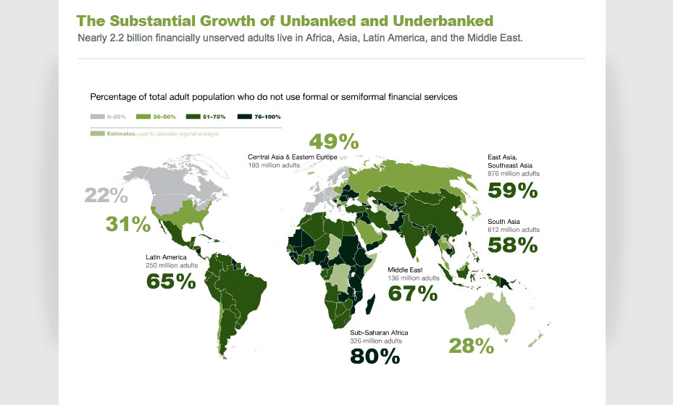
Target Audience

Slide 4
International mobile top-up from UK Telecom Distribution LTD
Simple, easy and profitable
As one of the largest providers of International Mobile Top-ups, we are dedicated to helping people connect.
UK Telecom Distribution Ltd creates your own branded International Mobile Top-up (IMTU) Service, supported by us.
Your customers can Top-up prepaid mobile accounts of friends and family, wherever they are in the world.

Slide 5
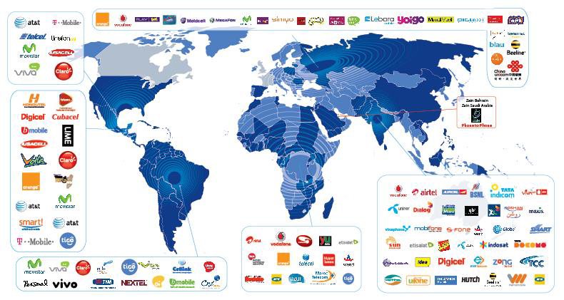
130+ Countries
300+ Networks

Slide 6

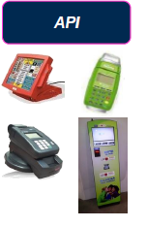
Application Programming interface
Direct Integration (API) for retailer groups with existing terminals and kiosks through our host to host connectivity.
UK Telecom establishes a secure connectivity to the Distributor’s Platform
Hierarchical Web Based Platform that includes full security features and reporting
24/7 NOC, Partner Support and Customer Care Teams

Slide 7

International Mobile Top-up (IMTU)
Ethnic minorities in the US/EU can top up the mobile phones of their families and friends back in their home countries
Our partners can benefit from:
Access to UK Telecom Distribution’s global hub sending top-ups to almost a 100 countries
Creation of a new revenue stream from this value-added service
Potential partnerships in all markets of your company’s presence

Slide 8

International Mobile Top-Up (IMTU)
Global IMTU potential market worth is estimated at US$ 8.6 billion
215 million foreign born across the globe
Top 10 biggest Sending markets:
  United States
  UAE
  Saudi Arabia
  United Kingdom
  Canada
  Germany
  France
  Spain
  Australia
  Italy

Slide 9














Here’s how it works
Connecting with people across the world has never been easier.
We deliver customer service capabilities that you and your customers can rely on.
We use our technology and experience to create a white-labelled service that delivers the right results for you.

Slide 10
Our partners can initiate transactions at:
Retail branches
Websites
Mobile wallets
ATMs
Payment kiosks
Mobile apps

Slide 11
IMTU Partner Security features
Per Transaction User Authentication: User Id and Password provided in each request
Session Based – Use API request (logon) to establish an API session. Application must re-authenticate when session expires
- IP Restriction
- SSL
- Method Access

Slide 12

IMTU Business Model
UK Telecom Distribution buys top-ups from MNOs worldwide and sells them to a partner when a customer makes a live request for it
Business to Business API provisioning
Wholesale business support structure
Discount off value transferred
Margins vary by destination and typically is in range of 10-20%

Slide 13
Benefits for Partners
UK Telecom Distribution LTD creates a new revenue stream for your Company
Provides white-labeled turn-key solution which can be easily deployed and scaled across all sales channels
Your Company launches a new relevant value-added service not offered by competitors
Your Company improves customer loyalty & keeps customers connected with their families and friends worldwide

Slide 14

Break up barriers,
Go Global.
Thank you

